Slide 1




Time Series Analysis
of Microsoft (MSFT)
Stock Prices
Univariate ARIMA · Multivariate VECM · ARCH / GARCH Volatility
Take Home Assignment
Ravindu Weerasekara - 226133E
Bavindu Gunasinghe - 226044G
Notes:
1

Slide 2
OVERVIEW
Presentation Outline
01
Data & Variables
Data — sources, coverage, descriptive statistics
02
Task 1 · Univariate ARIMA
Stationarity → Seasonality → ACF/PACF → SARIMA(1,1,1)(0,0,1)₅ → Forecast
03
Task 2 · Multivariate VECM
Cointegration → VECM(k=8) → IRF → Out-of-sample validation
04
Task 3 · ARCH / GARCH
ARCH-LM test → GARCH(1,1)-t selection → Volatility forecast
05
Conclusions
Key findings
Notes:
2

Slide 3
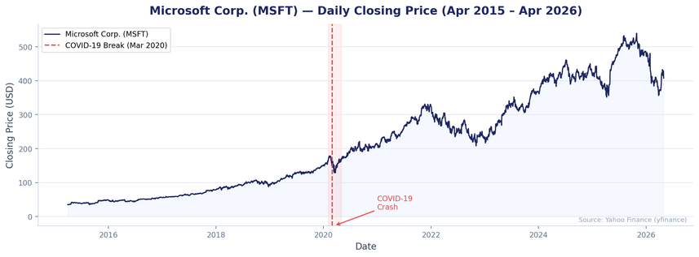
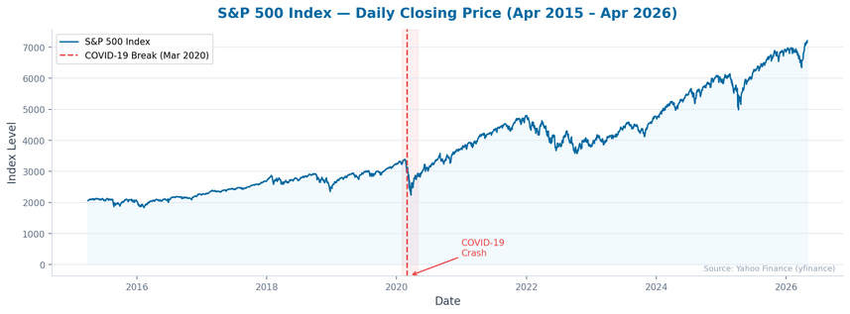
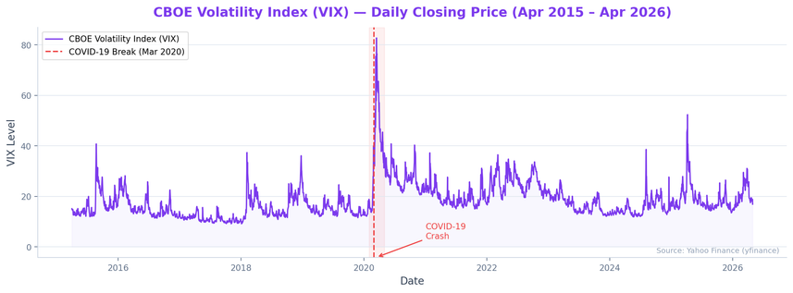
01
DATA
Data Description & Variable Justification
MSFT — Microsoft Corp.
SP500 — S&P 500 Index
VIX — CBOE Volatility Index
  Dependent variable.
  Daily closing price from NASDAQ.
  Strong upward trend with COVID-19 structural break (Mar 2020).
  Market-wide momentum indicator.
  Highly correlated with MSFT.
  Captures broad equity market dynamics for cointegration.
  Market fear gauge
  Inversely correlated with equities.
  Spikes during stress events - key driver of short-run MSFT dynamics.
Source
Coverage
Frequency
Observations
Yahoo Finance (https://finance.yahoo.com/)
Apr 2015 – Apr 2026
Daily (Business Days)
2,787 (no missing values)
Notes:
3

Slide 4
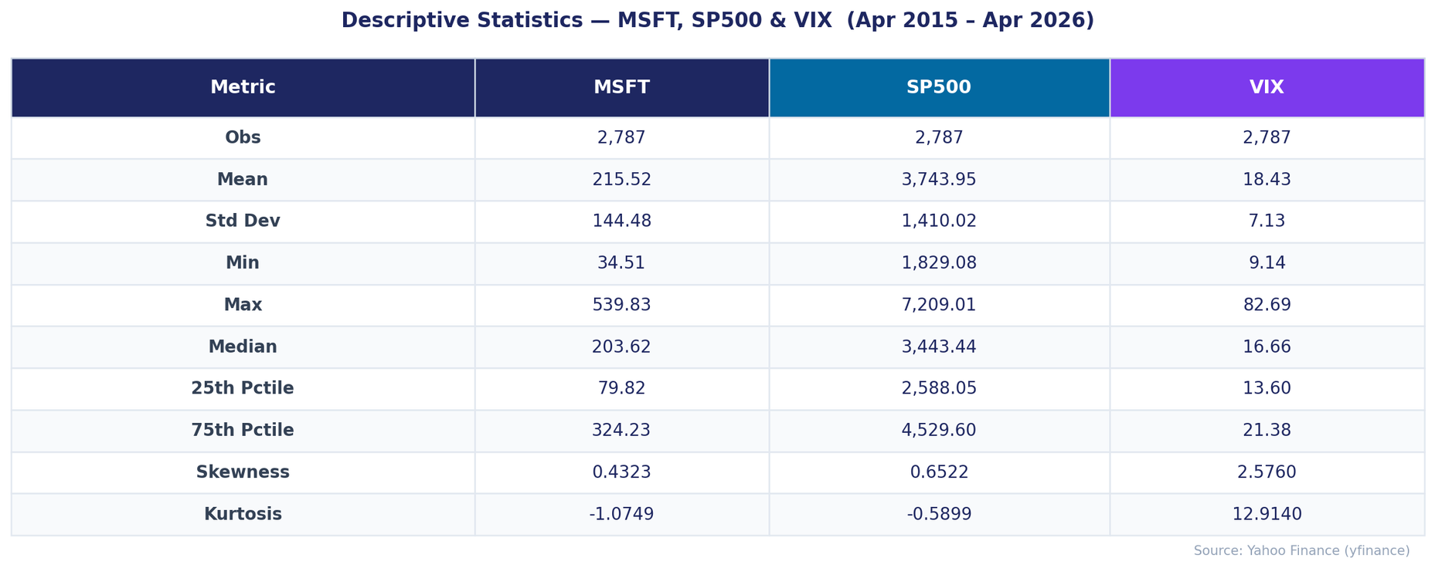
01
DATA
Descriptive Statistics
Notes:
3

Slide 5
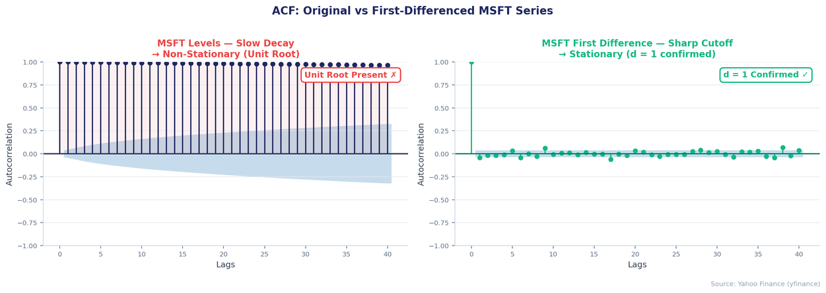
02
TASK 1 · ARIMA
Stationarity Testing
Series | ADF Statistic | ADF p-value | KPSS Statistic | KPSS p-value | Verdict
MSFT (Levels) | -0.610 | 0.869 | 8.368 | 0.010 | Non-Stationary ✗
MSFT (1st Diff) | -17.525 | 0.000 *** | 0.054 | 0.100 | Stationary ✓
ADF Test (H₀: Unit Root exists)
Levels: p = 0.869 → FAIL to reject → unit root present
First diff: p = 0.000 → reject → stationary ✓
KPSS Test (H₀: Series is stationary)
Levels: p = 0.010 → REJECT stationarity → non-stationary
First diff: p = 0.100 → fail to reject → stationary ✓
Conclusion: d = 1
  Both ADF and KPSS agree MSFT daily prices are integrated of order one I(1).
  First differencing produces a stationary series suitable for ARIMA modelling.
Notes:
4

Slide 6
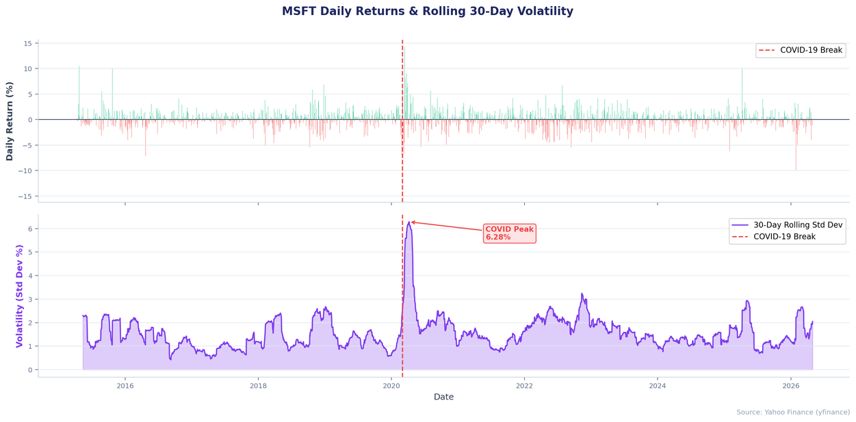
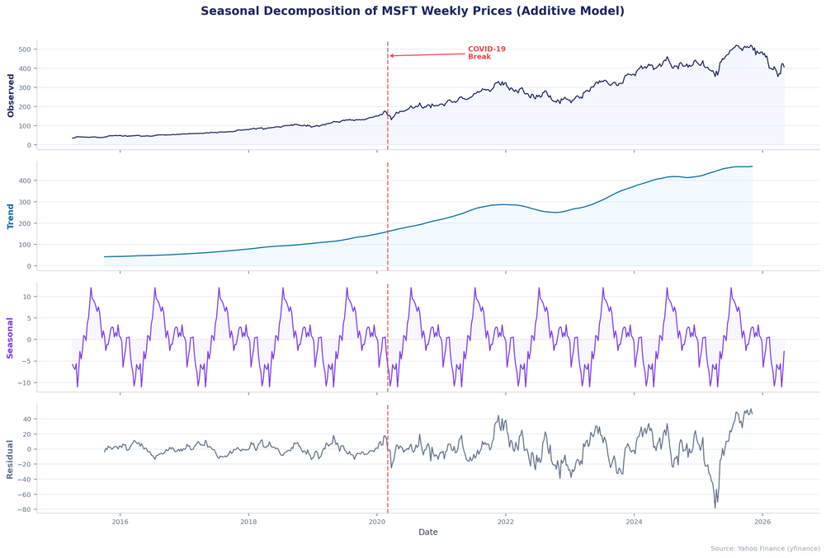
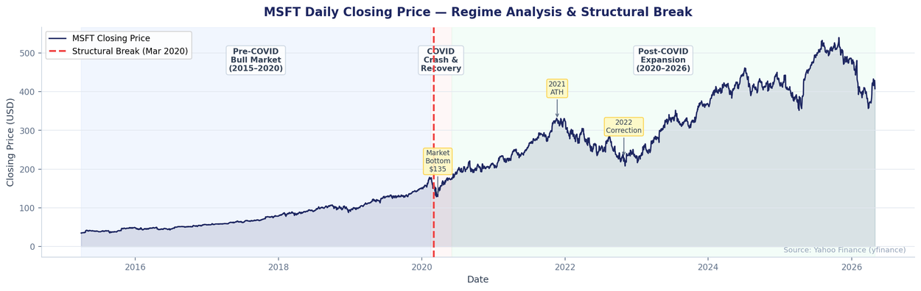
02
TASK 1 · ARIMA
Seasonality, Structural Breaks & Volatility Clustering
Key finding:
All three visuals collectively justify the SARIMA seasonal specification (m = 5), the structural break adjustment (Mar 2020), and the need for GARCH volatility modelling forming the analytical foundation for Tasks 1, 2 and 3.
Notes:
4

Slide 7
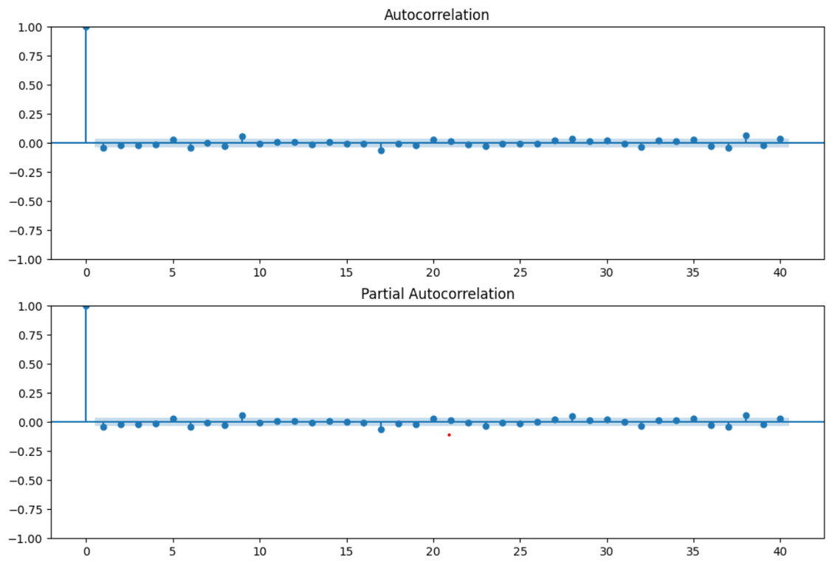
02
TASK 1 · ARIMA
ACF / PACF Analysis
ACF / PACF Analysis — First Differenced Series
ACF lag 1:
Significant spike
→ q = 1 (MA component)
PACF lag 1:
Significant spike
→ p = 1 (AR component)
Lags 5, 10, 15:
Mild recurring spikes
→ seasonal period m = 5
Higher lags:
Within 95% confidence bands → no overdifferencing
Seasonal m =5:
Reflects five-day trading week cycle
Notes:
5

Slide 8
02
TASK 1 · ARIMA
Model Identification & Selection
Auto ARIMA
Model Comparison
Model | AIC | BIC
ARIMA(1,1,1) | 15,825.42 | 15,848.97
SARIMA(1,1,1)(0,0,1)₅ ★ | 15,823.70 | 15,848.99
SARIMA(1,1,1)(0,0,1)₅ selected
  lowest AIC.
  Seasonal MA component adds meaningful fit.
Fitted Model Parameters — SARIMA(1,1,1)(0,0,1)₅
Metric | Value | Metric | Value
Log-Likelihood | -7,908.63 | Ljung-Box p (lag 10) | 0.127 ✓
AIC | 15,825.27 | Ljung-Box p (lag 20) | 0.067 ✓
BIC | 15,849.00 | Ljung-Box p (lag 30) | 0.057 ✓
Notes:
5

Slide 9
02
TASK 1 · ARIMA
Forecasting & Out-of-Sample Validation
$408.73
$409.43
22.60
24.57
Day-1 Forecast (1 May 2026)
Converged Forecast (30 days)
Out-of-Sample MAE ($)
Out-of-Sample RMSE ($)
30-Day Price Forecast
Out-of-Sample Validation (Last 30 Days)
  MSFT forecast converges toward ~$409.43 over 30 business days (May–June 2026).
  95% CI widens from ±$8 on Day 1 to ±$34 by Day 30, reflecting increasing uncertainty.
  Near-flat trajectory is consistent with the near-random-walk nature of daily stock prices.
  RMSE $24.57 ≈ 6% of mean MSFT test price — reasonable short-term accuracy.
  RMSE slightly > MAE confirms a few larger errors, consistent with high-volatility episodes in the test period.
  Provides benchmark for comparison with VECM in Task 2.
Notes:
6

Slide 10
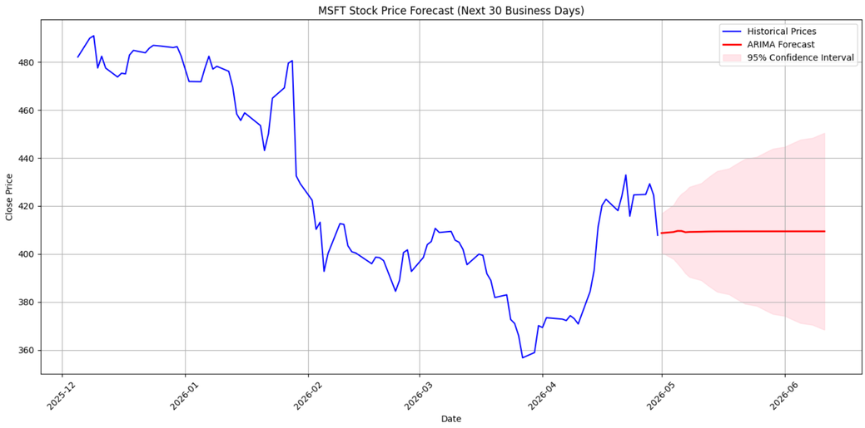
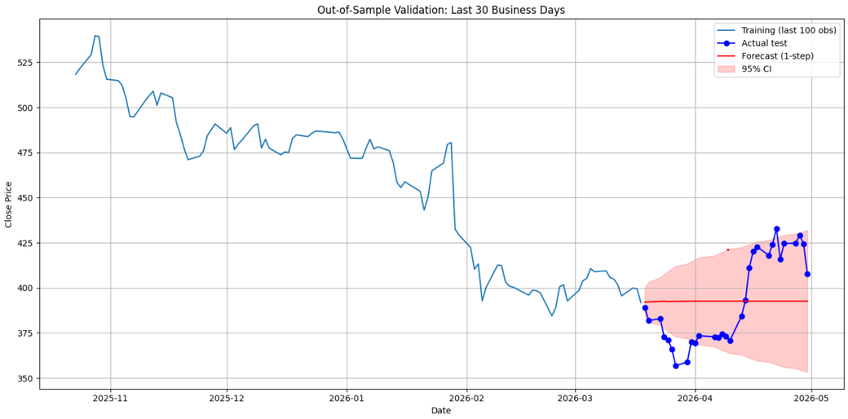
02
TASK 1 · ARIMA
Forecasting & Out-of-Sample Validation
30-Day Price Forecast
Out-of-Sample Validation (Last 30 Days)
Notes:
6

Slide 11
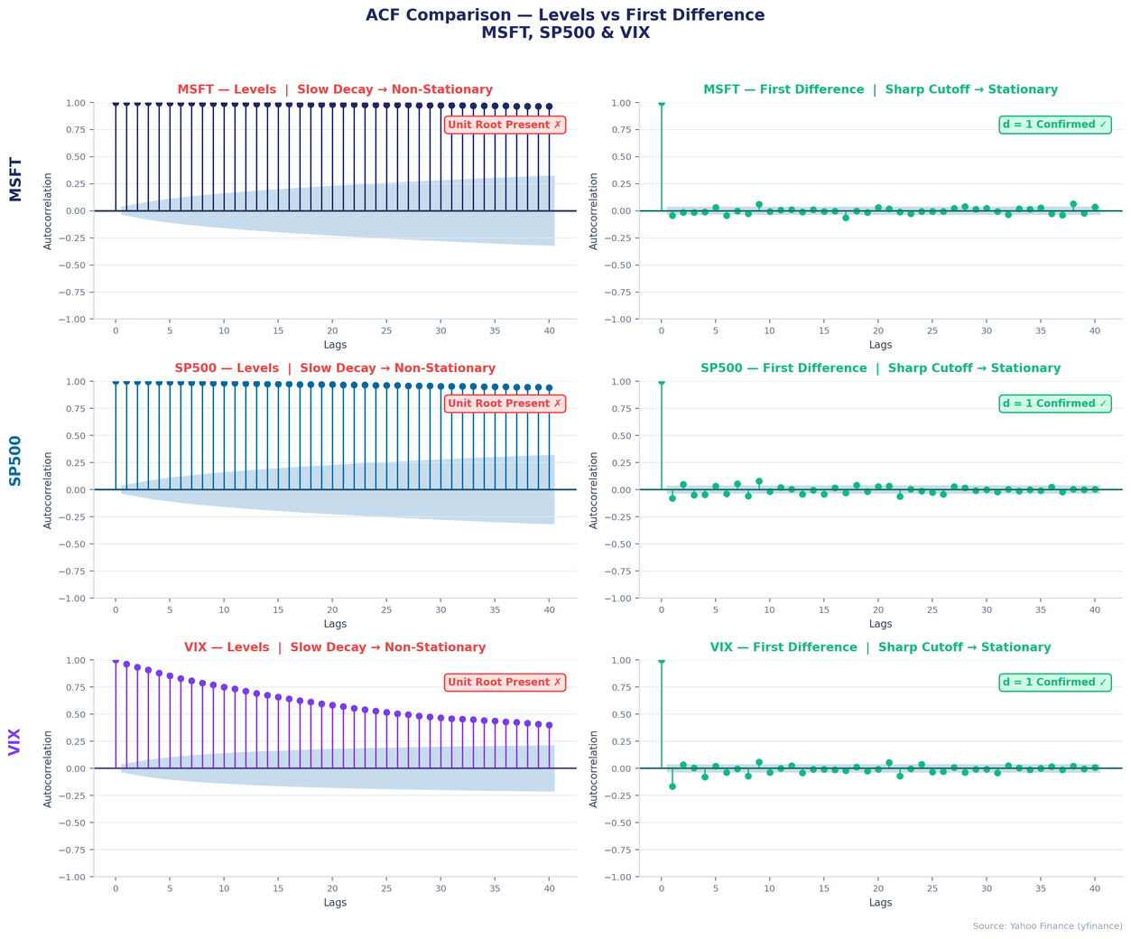
03
TASK 2 · VECM
Stationarity Testing
Stationarity — All Three Variables
Variable | ADF p-value | Verdict
MSFT (Level) | p = 0.869 ✗ | Non-Stationary
SP500 (Level) | p = 0.996 ✗ | Non-Stationary
VIX (Level) | p = 0.000 | Mixed
Stationarity — All Three Variables
Variable | ADF p-value | Order
MSFT (1st Dif) | P = 0.000 | I(1)
SP500 (1st Dif) | p = 0.000 | I(1)
VIX (1st Dif) | p = 0.000 | I(1) treated
  All first differences are stationary (ADF p ≈ 0.000, KPSS p = 0.100).
  All series treated as I(1) → cointegration test appropriate.
Notes:
7

Slide 12
03
TASK 2 · VECM
Cointegration & Model Choice
Johansen Cointegration Test (95% CV)
H₀ | Trace Stat | 95% CV | Decision
r ≤ 0 | 78.391 | 29.796 | REJECT ✗
r ≤ 1 ★ | 10.137 | 15.494 | Fail to Reject
r ≤ 2 | 2.219 | 3.841 | Fail to Reject
Max-Eigen test confirms: r = 0 rejected (68.254 >> 21.131); r = 1 not rejected.
→ Exactly ONE cointegrating vector. VECM preferred over VAR in differences.
Lag Order Selection: k_ar_diff = 8 chosen via residual diagnostic search
k=5: SP500 FAIL
k=6: SP500 FAIL
k=7: VIX FAIL
k=8: All Pass ✓
Notes:
7

Slide 13
03
TASK 2 · VECM
VECM Results & Diagnostics
Key VECM Coefficients — MSFT Equation
VECM Residual Diagnostics (Ljung-Box Test at Lag 10)
Coefficient | Value | p-value
L1.VIX | +0.2301 | 0.000 ***
L2.MSFT | −0.0785 | 0.003 ***
L3.SP500 | −0.0146 | 0.000 ***
L5.MSFT | +0.0559 | 0.037 **
MSFT Resid
SP500 Resid
LB p = 0.854 ✓
LB p = 0.443 ✓
VIX Resid
LB p = 0.734 ✓
L1.VIX: +0.23 → VIX spike leads to short-run MSFT price uptick (mean-reversion)
L2.MSFT: −0.08 → Mild own-lag mean reversion
L3.SP500: −0.015 → Short-run SP500 correction feeds into MSFT
All three equations pass the residual autocorrelation test comfortably (p >> 0.05), confirming that the VECM with k_ar_diff = 8 has successfully captured the dynamic structure in all three series.
Notes:
8

Slide 14
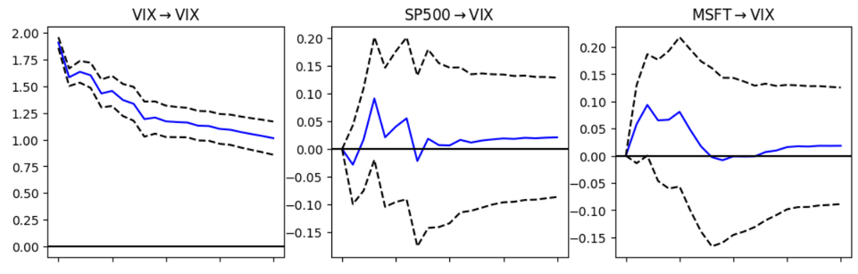
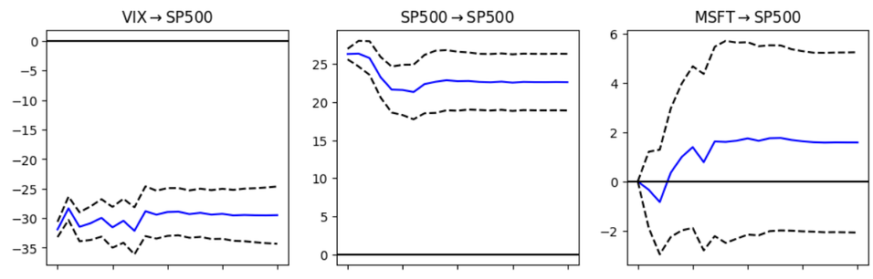
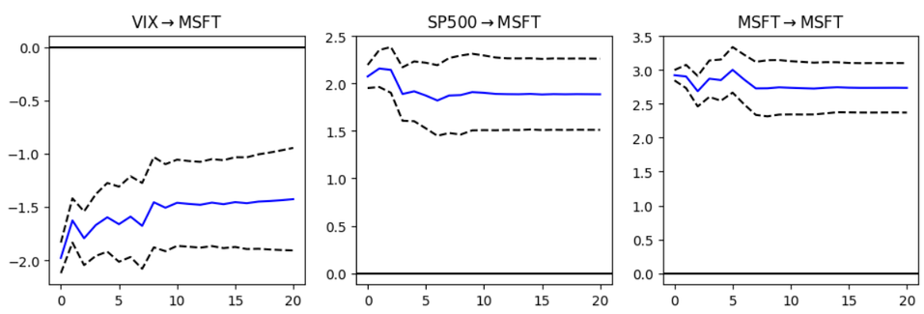
03
TASK 2 · VECM
Impulse Responses
Impulse Response Functions (VIX → SP500 → MSFT)
VIX shock → MSFT:
Negative short-run response — risk-off behaviour
SP500 shock → MSFT:
Positive transmission within 2–3 trading days
MSFT shock → SP500/VIX:
Minimal spillback — MSFT is price-taker
Decay horizon:
All IRFs converge to zero within 10–15 periods
Cholesky ordering:
VIX (exogenous) → SP500 → MSFT (firm-level)
Notes:
8

Slide 15
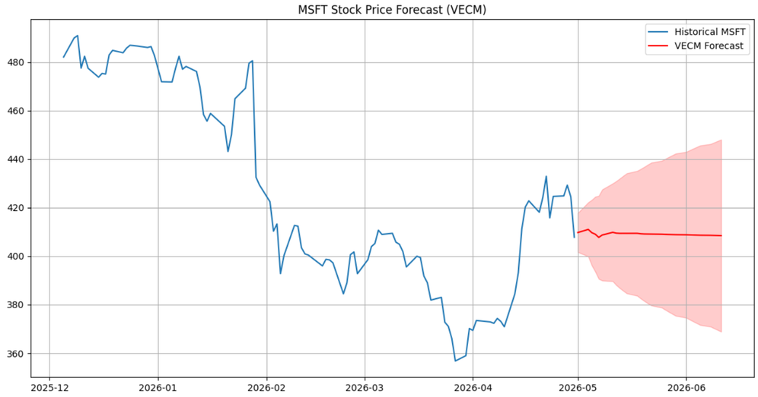
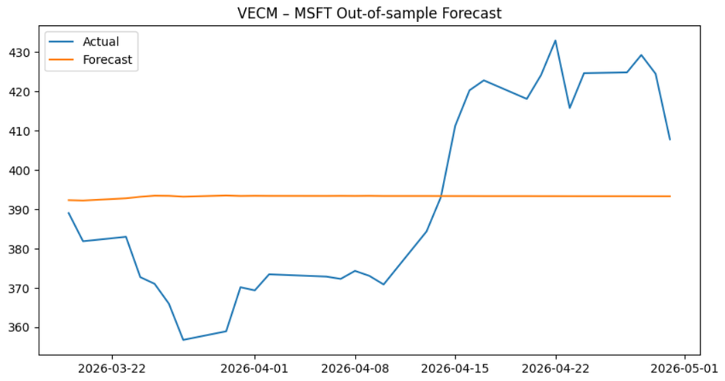
03
TASK 2 · VECM
Forecasting & Out-of-Sample Validation
30-Day Price Forecast
Out-of-Sample Validation (Last 30 Days)
MSFT RMSE
MSFT MAE
$24.59
$22.69
Notes:
8

Slide 16
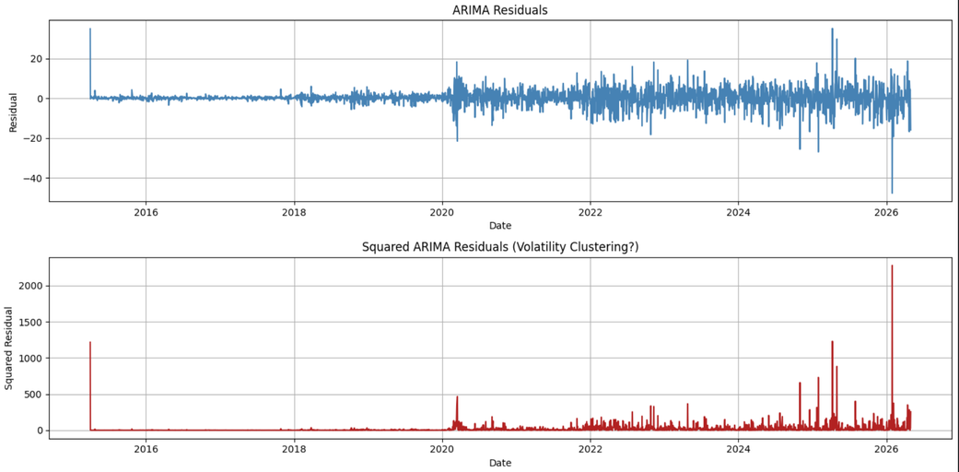
04
TASK 3 · GARCH
Conditional Heteroscedasticity — ARCH-LM Tests
ARCH-LM Test — ARIMA Residuals
Lags | LM Stat | p-value | Result
5 | 123.171 | 0.000 *** | ARCH ✗
10 | 156.197 | 0.000 *** | ARCH ✗
15 | 183.689 | 0.000 *** | ARCH ✗
LM statistics increase with lag (123→156→184) confirming persistent volatility clustering — not a short-lived effect. Squared residuals visually confirm COVID-19 spike (Mar 2020).
Notes:
9

Slide 17
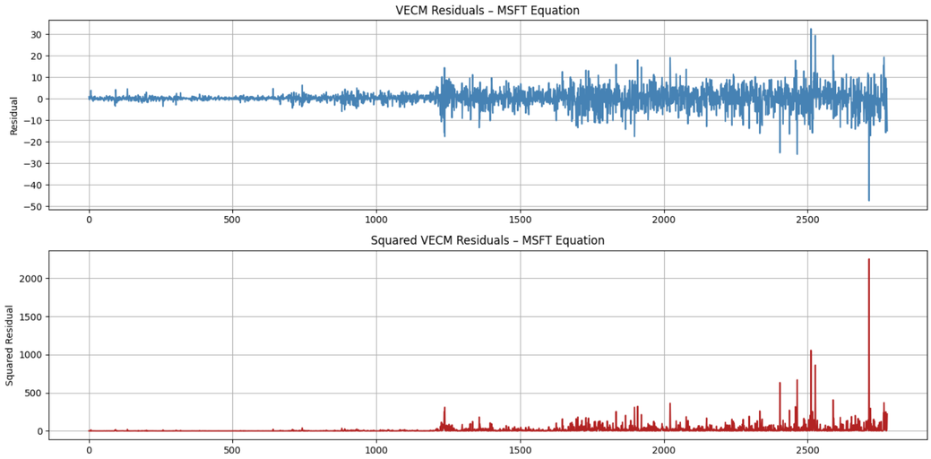
04
TASK 3 · GARCH
Conditional Heteroscedasticity — ARCH-LM Tests
ARCH-LM Test — VECM Residuals (MSFT)
Lags | LM Stat | p-value | Result
5 | 111.192 | 0.000 *** | ARCH ✗
10 | 141.416 | 0.000 *** | ARCH ✗
15 | 167.983 | 0.000 *** | ARCH ✗
Slightly lower LM stats than ARIMA (111 vs 123 at lag 5) — VECM absorbs some volatility via SP500 and VIX channels. Significant ARCH effects persist regardless — GARCH required for both models.
Conclusion: Both the ARIMA and VECM models exhibit strong conditional heteroscedasticity (p ≈ 0.000 at all lags tested). GARCH modelling is necessary and justified for both.
Notes:
9

Slide 18
04
TASK 3 · GARCH
GARCH Model Selection & Parameter Estimates
Model Comparison — ARIMA Residuals
GARCH(1,1)-t Parameters — ARIMA Residuals
Model | AIC | BIC | Log-Lik
GARCH(1,1)–Normal | 13,223.74 | 13,247.47 | −6,607.87
GARCH(1,1)–t ★ BEST | 12,833.43 | 12,863.09 | −6,411.72
EGARCH(1,1) | 13,164.01 | 13,187.74 | −6,578.00
GJR-GARCH | 13,225.71 | 13,255.37 | −6,607.86
omega
0.0123
p=0.013
alpha₁ (ARCH)
0.1343
p=0.000
beta₁ (GARCH)
0.8657
p=0.000
ν (d.o.f.)
5.066
p=0.000
GARCH(1,1)-t wins by 390 AIC points over Normal GARCH — confirms fat-tailed returns. Asymmetric models (EGARCH, GJR) do not improve — leverage effects are not dominant.
α₁ + β₁ = 1.0000
Near-IGARCH: Volatility shocks are extremely persistent
alpha₁ = 0.134: Shocks raise conditional variance by 13.4% | beta₁ = 0.866: 86.6% of yesterday's volatility persists | ν = 5.07: Very fat tails confirmed — extreme MSFT price moves are far more frequent than Normal distribution predicts
Notes:
10

Slide 19
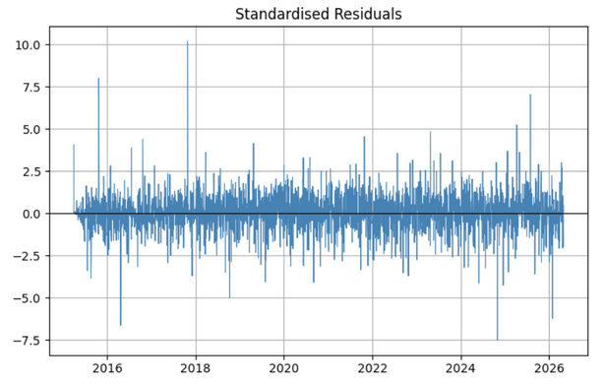
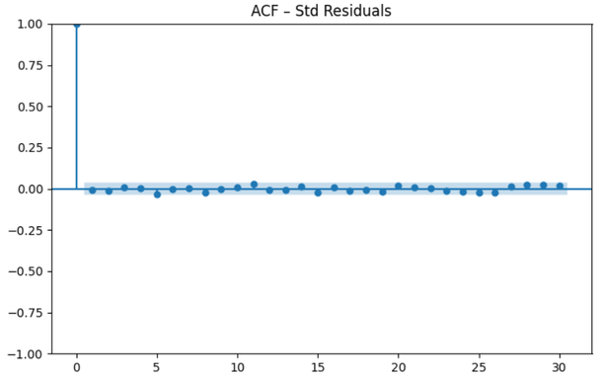
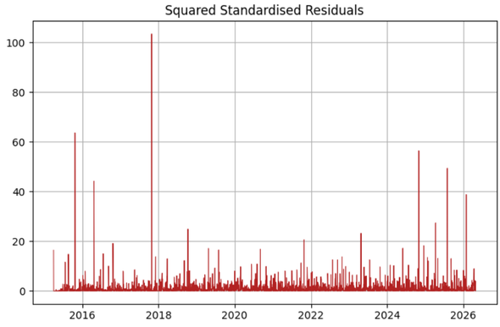
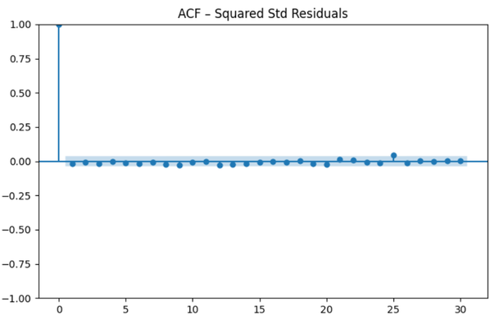
04
TASK 3 · GARCH
GARCH Diagnostics
Post-GARCH Diagnostics — Standardised Residuals
Test | Lags | p-value | Result
Ljung-Box (std) | 10 | 0.847 | No autocorr ✓
Ljung-Box (std) | 20 | 0.892 | No autocorr ✓
Ljung-Box (std²) | 10 | 0.638 | No ARCH ✓
Ljung-Box (std²) | 20 | 0.721 | No ARCH ✓
ARCH-LM (std) | 5 | 0.752 | ARCH removed ✓
ARCH-LM (std) | 10 | 0.581 | ARCH removed ✓
Before vs After GARCH(1,1)-t
Before
After
ARCH-LM (lag 10)
p = 0.000 ❌
p = 0.581 ✓
LB Squared (lag 10)
significant ❌
p = 0.638 ✓
Notes:
11

Slide 20
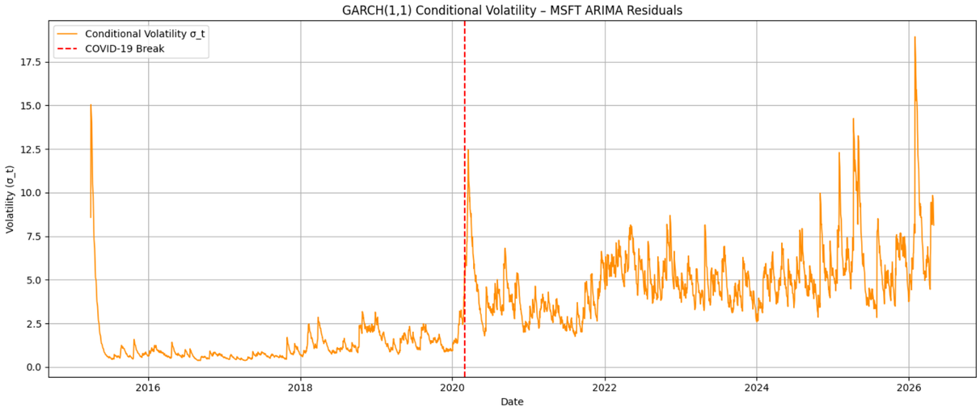
04
TASK 3 · GARCH
Conditional Volatility
Key Observations
  Pre-2020: Low, stable volatility consistent with the prolonged bull market following the 2015–2016 correction.
  COVID-19 Spike (Mar 2020): Largest volatility surge in the full sample. Confirms the structural break identified in Task 1.
  Post-2020 Recovery: Gradual decline but remains elevated above pre-COVID levels — driven by high GARCH persistence (β₁ = 0.866).
  2022 Correction: Secondary spike linked to the Federal Reserve's aggressive interest rate hiking cycle and the broad equity selloff.
  Conclusion: GARCH(1,1)-t successfully captures all four volatility regimes that the SARIMA conditional mean model entirely misses.
Notes:
11

Slide 21
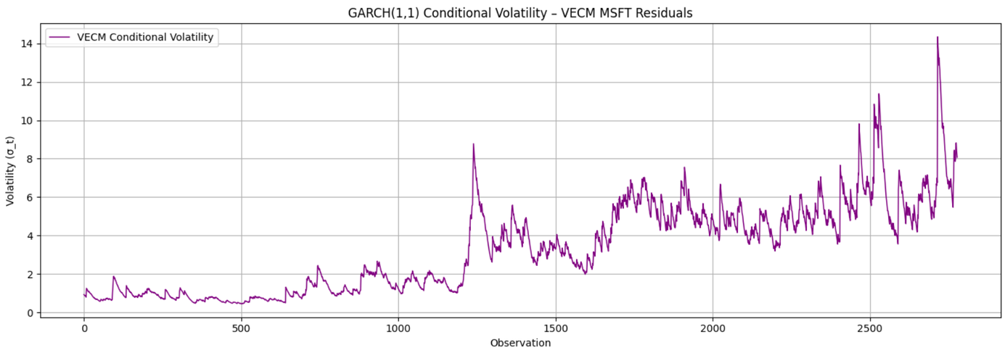
04
TASK 3 · GARCH
GARCH Model Selection & Parameter Estimates
GARCH(1,1)-t on VECM Residuals — MSFT Equation:
omega
0.0061
p=0.156
alpha₁ (ARCH)
0.0721
p=0.000
beta₁ (GARCH)
0.9279
p=0.000
  Lower alpha1 (0.072 vs 0.134): The VECM residuals react less sharply to new shocks, because SP500 and VIX in the VECM already absorb part of the contemporaneous market shock before it reaches the MSFT equation residual.
  Higher beta1 (0.928 vs 0.866): Volatility persistence is even stronger in the VECM residuals, meaning once volatility is elevated in the multivariate system, it takes longer to dissipate.
  omega not significant (p = 0.156): The long-run variance baseline is imprecisely estimated, which is common when persistence is very high (near-IGARCH behaviour).
α₁ + β₁ = 1.0000
Volatility shocks are extremely persistent
Notes:
10

Slide 22
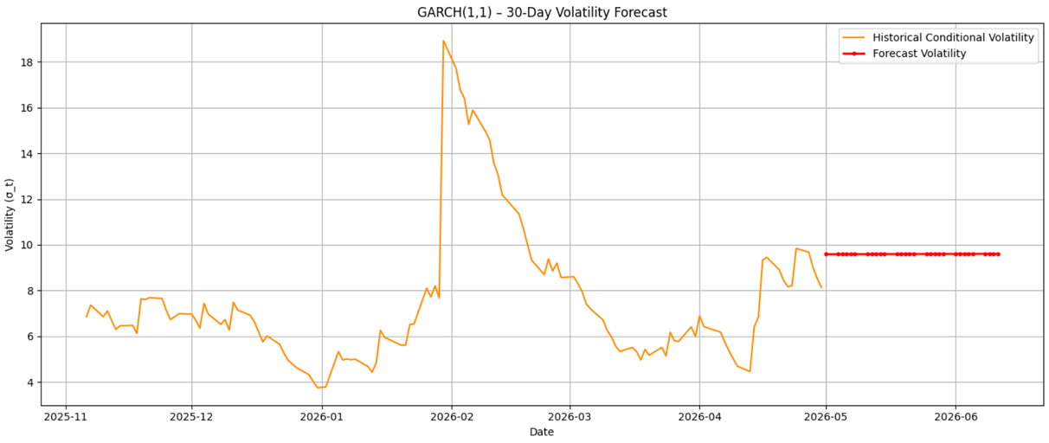
04
TASK 3 · GARCH
Volatility Forecast (30 Days)
30-Day Volatility Forecast (May–Jun 2026)
$9.59
~2.3%
Day-1 Forecast σ
Daily Volatility %
Forecast rises very slowly from 9.586 to 9.605 over 30 days — near-flat trajectory reflects near-IGARCH persistence. Variance: 91.90 → 92.26.
Notes:
11

Slide 23
Conclusions & Key Findings
01
MSFT prices are I(1)
Both ADF and KPSS confirm unit root in levels; first-differenced series is stationary → d = 1.
02
SARIMA(1,1,1)(0,0,1)₅ captures conditional mean
Lowest AIC among candidates; white-noise residuals (LB p > 0.05); RMSE $24.57 on 30-day holdout.
03
One cointegrating vector justifies VECM
Johansen trace & max-eigen tests agree r = 1. VECM (k=8) achieves identical MSFT RMSE to SARIMA with added structural insight.
04
Strong ARCH effects in both models
ARCH-LM rejects homoscedasticity at p ≈ 0.000 for ARIMA and VECM residuals — volatility clustering is pervasive.
05
GARCH(1,1)-t is the best volatility model
390-point AIC advantage over Normal GARCH. ν = 5.07 confirms fat tails. Persistence α+β = 1.00 indicates near-IGARCH behaviour.
Notes:
12

